Slide 1
GENES TO PROTEINS
Campbell
Chapter 17

Slide 2
transcription
translation
DNA RNA PROTEINS
Somehow info from DNA must be read & proteins must be made
DNA doesn’t leave the nucleus
a special molecule called m-RNA is using the pattern of DNA
This process is called: Transcription
The m-RNA leaves the nucleus
It is “read” in order for polypeptide chains to be assembled on ribosomes
This process is called: Translation

Slide 3
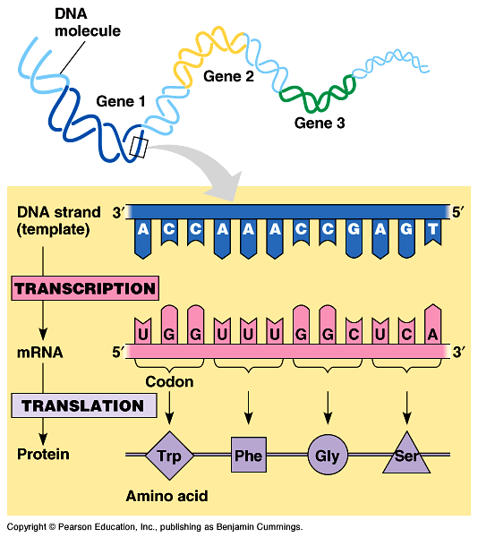

Slide 4
What is RNA?
DNA is deoxyribonucleic acid
RNA is ribonucleic acid
It contains ribose instead of deoxyribose
It is typically a single-stranded molecule
It has URACIL instead of THYMINE
There are 3 types of RNA:
mRNA (messenger RNA)
tRNA (transfer RNA)
rRNA (ribosomal RNA)

Slide 5
GENETIC CODE
The Triplet Code:
CODON-on mRNA
ANTICODON-on tRNA
*Appropriate amino Acids are biochemically attracted to the other end of the tRNA

Slide 6
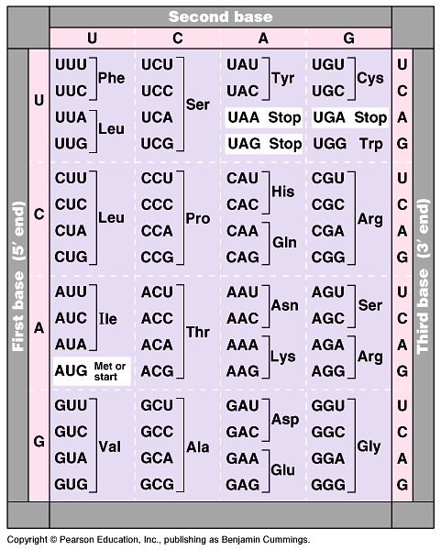

Slide 7
Transcription
Occurs in the nucleus
RNA polymerase opens DNA to expose a gene
A gene is simply a “recipe” of a long sequence of DNA base-pairs
DNA is opened at the promotor region
The gene ends at the terminator region
Therefore, mRNA is made by literally copying* the gene
Before the mRNA can leave the nucleus, finishing touches must be made…
* actually a complementary copy

Slide 8
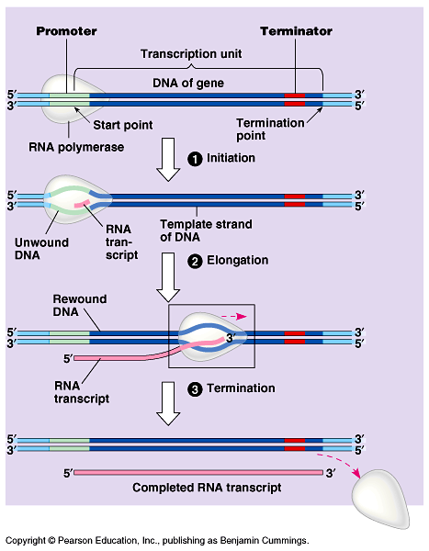
The stages of transcription: initiation, elongation, and termination

Slide 9
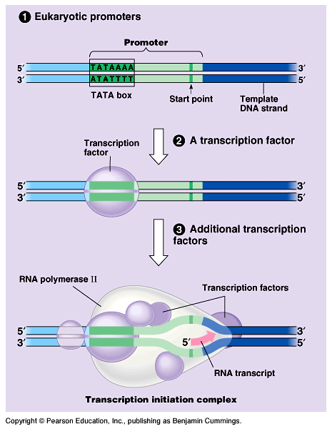
The initiation of transcription at a eukaryotic promoter

Slide 10
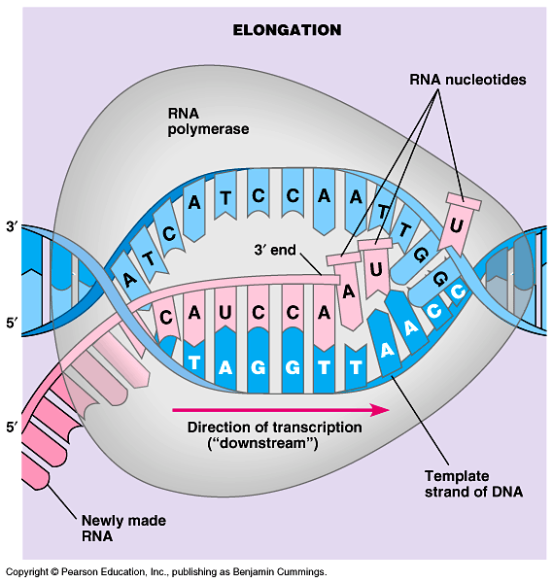

Slide 11
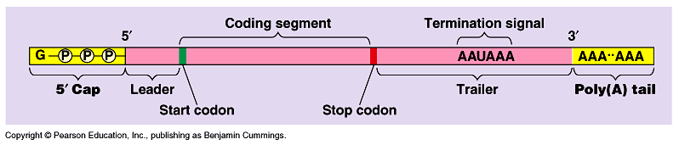

Slide 12
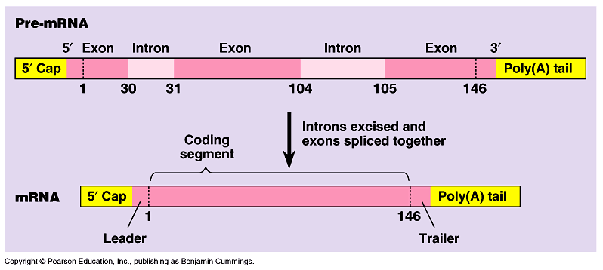

Slide 13
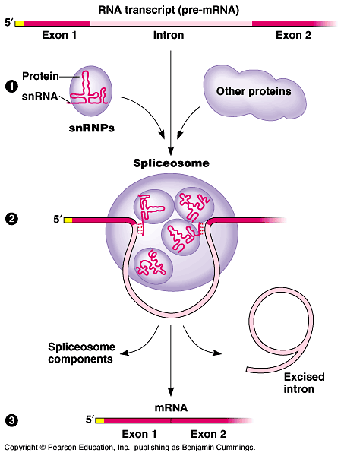
The roles of snRNPs and spliceosomes in mRNA splicing

Slide 14
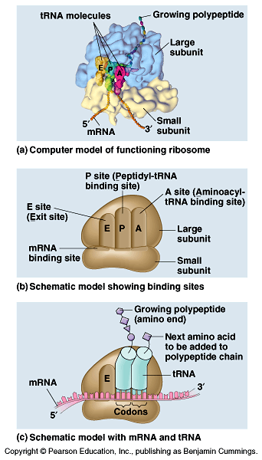
Ribosome anatomy
Three sites in ribosome:
E = exit site
P = binding site
A = entry site

Slide 15
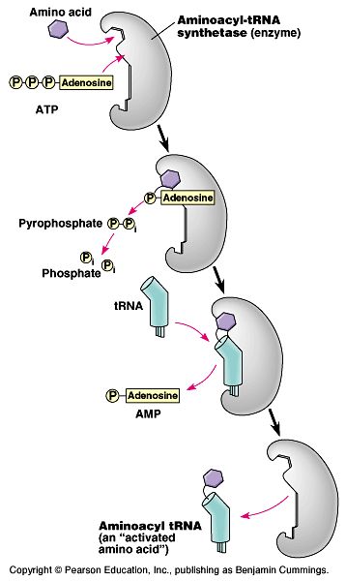
An aminoacyl-tRNA synthetase joins a specific amino acid to a tRNA

Slide 16
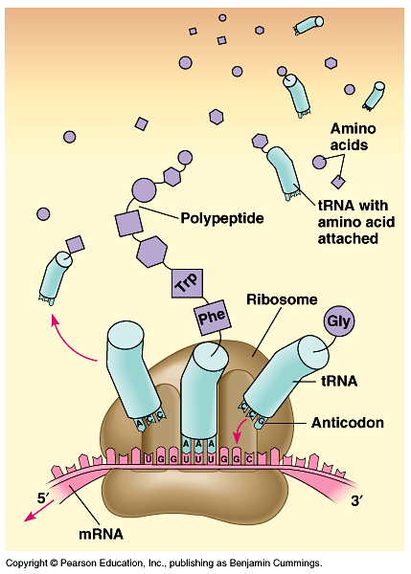
Translation: the basic concept

Slide 17
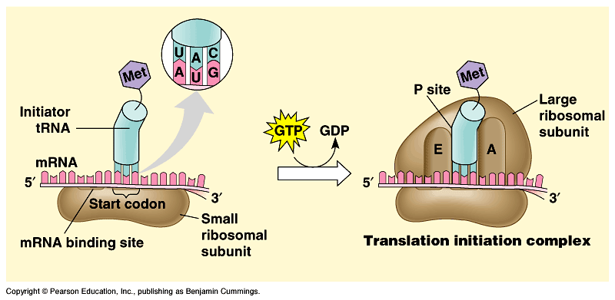
Initiation of Translation
Ribosome attaches to the start codon (AUG) of the mRNA
An initiation complex forms where the small subunit combines with mRNA, and initiator tRNA attaches with its amino acid.

Slide 18
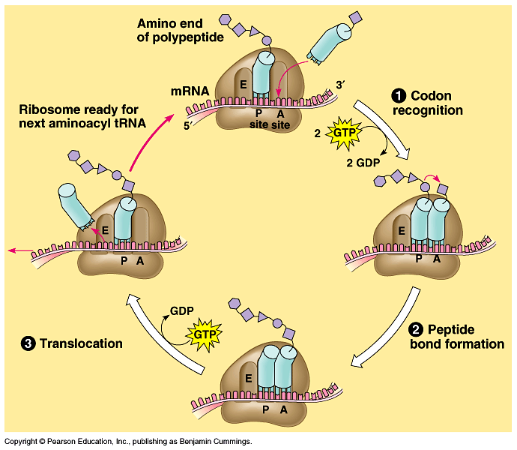
The elongation cycle of translation

Slide 19
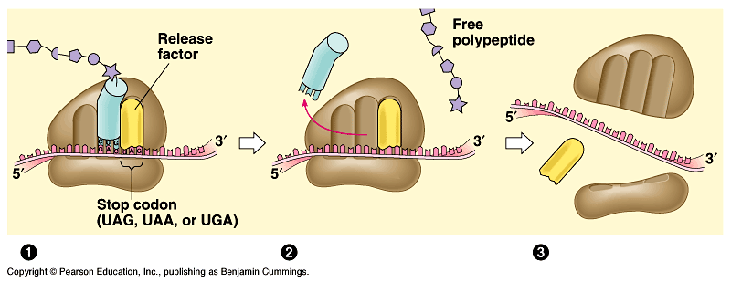
Termination
Stops at an mRNA stop codon by the binding of proteins (release factors – the last tRNA does not carry an AA, but these special proteins instead).
The last tRNA is released from the ribosome and everything separates (ribosome subunits break and are recycled).
New polypeptide (protein) is released.

Slide 20
Translation
Occurs in the cytoplasm & on ribosomes
mRNA attaches to the ribosome
INITIATION
“Start” codon is read
ELONGATION
One at a time, amino acids are brought over to ribosomes by specific tRNA’s
Amino acids covalent bond to one another forming a polypeptide chain
TERMINATION
A “stop” codon is read & terminates the process

Slide 21
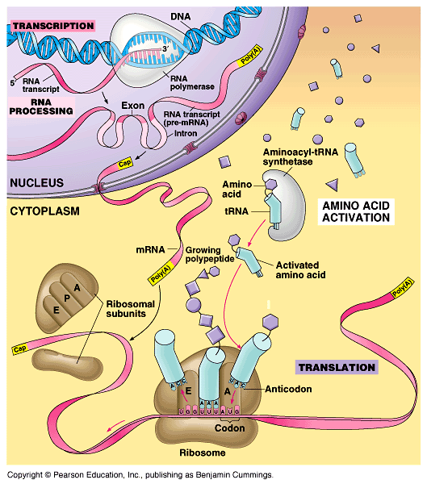
A summary of transcription and translation in a eukaryotic cell

Slide 22
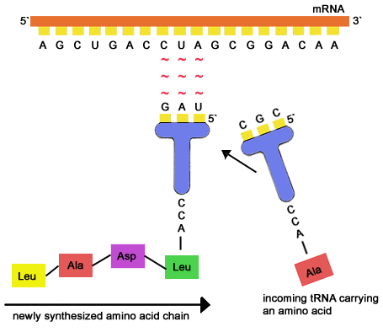

Slide 23
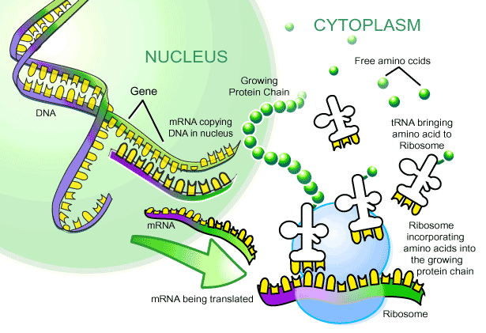

Slide 24
Eukaryotic vs. Prokaryotic protein synthesis
Prokaryotes don’t have nuclei, so they need not wait for mRNA to exit the nucleus
Very little RNA processing in prokaryotes, so mRNA is translated very quickly
Ribosomes attach to mRNA and protein synthesis begins before transcription is complete.
Once mRNA enters cytoplasm of eukaryote, many copies of the proteins can be made at a time. Once one ribosome has moved along the mRNA, another can attach and do the same.

Slide 25
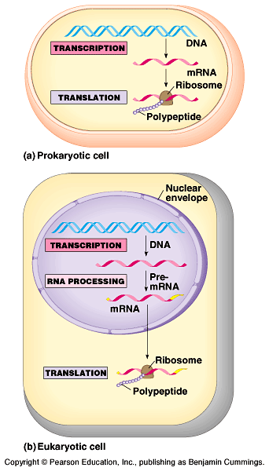
Overview: the roles of transcription and translation in the flow of genetic information

Slide 26
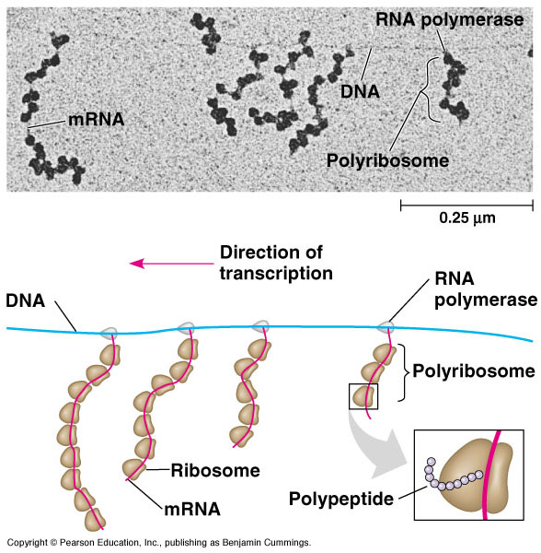
Coupled transcription and translation in bacteria

Slide 27
Great summary (15 minutes…view on your own) of DNA REPLICATION, TRANSCRIPTION AND TRANSLATION. THE BIG PICTURE. https://www.khanacademy.org/science/ap-biology/gene-expression-and-regulation/translation/v/rna-transcription-and-translation
And protein synthesis. https://www.khanacademy.org/science/ap-biology/gene-expression-and-regulation/translation/v/translation-mrna-to-protein

Slide 28
Point Mutations
Mutations occurring in DNA often show up during translation
Base-pair substitution
WOBBLE EFFECT
Insertion/deletion causes a frameshift
Transposable elements
Cause of mutations:
radiation (UV & x-rays)
carcinogens (cancer causing agents)

Slide 29
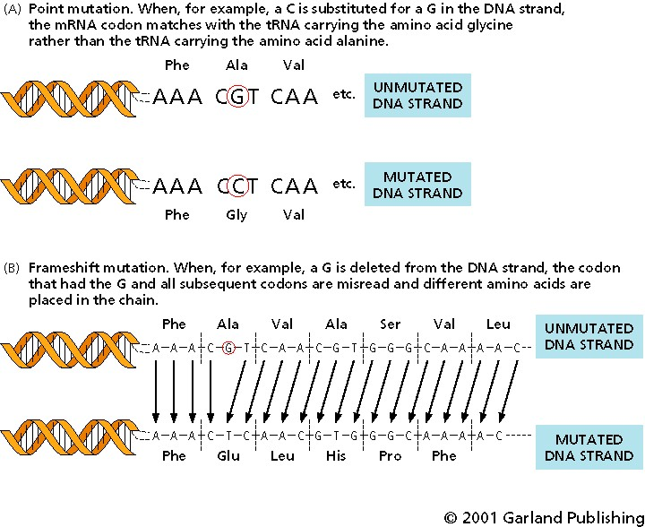

Slide 30
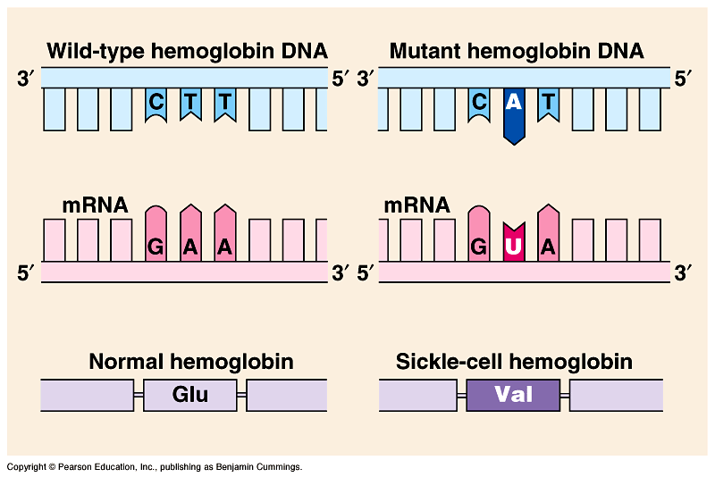
The molecular basis of sickle-cell disease: a point mutation

Slide 31
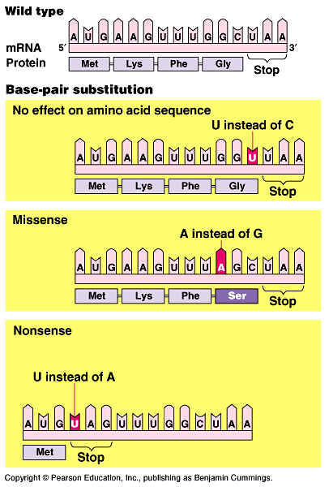
Categories and consequences of point mutations: Base-pair substitution

Slide 32
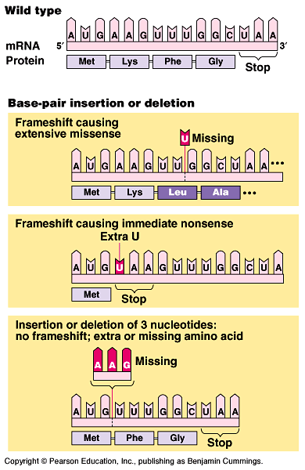
Categories and consequences of point mutations: Base-pair insertion or deletion

